Slide 1
PPT 2

Slide 2
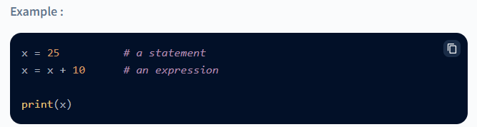
Expressions
A combination of operands and operators is called an expression. The expression in Python produces some value or result after being interpreted by the Python interpreter.
An expression in Python is very different from statements in Python. A statement is not evaluated for some results. A statement is used for creating variables or for displaying values.

Slide 3
There are many types of operators in Python, some of them are :
+ : add (plus).
- : subtract (minus).
x : multiply.
/ : divide.
** : power.
% : modulo.
<< : left shift.
>> : right shift.
& : bit-wise AND.

Slide 4
| : bit-wise OR.
^ : bit-wise XOR.
~ : bit-wise invert.
< : less than.
> : greater than.
<= : less than or equal to.
>= : greater than or equal to.
== : equal to.
!= : not equal to.
and : boolean AND.
or : boolean OR.
not : boolean NOT.

Slide 5
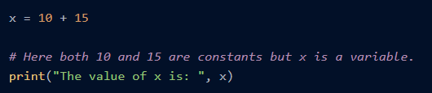
Type of Expressions in Python
1. Constant Expressions
A constant expression in Python that contains only constant values is known as a constant expression. In a constant expression in Python, the operator(s) is a constant.
2. Arithmetic Expressions
An expression in Python that contains a combination of operators, operands, and sometimes parenthesis is known as an arithmetic expression. The result of an arithmetic expression is also a numeric value

Slide 6
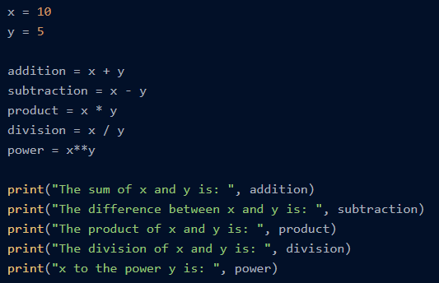

Slide 7
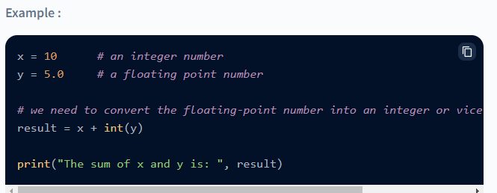
3. Integral Expressions
An integral expression in Python is used for computations and type conversion (integer to float, a string to integer, etc.). An integral expression always produces an integer value as a resultant.

Slide 8
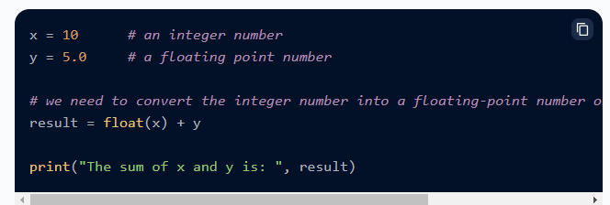
4. Floating Expressions
A floating expression in Python is used for computations and type conversion (integer to float, a string to integer, etc.). A floating expression always produces a floating-point number as a resultant.

Slide 9
5. Relational Expressions
A relational expression in Python can be considered as a combination of two or more arithmetic expressions joined using relational operators. The overall expression results in either True or False (Boolean result). We have four types of relational operators in Python (.>,<,>=,<=)
A relational operator produces a Boolean result so they are also known as Boolean Expressions.
a = 25
b = 14
c = 48
d = 45
# The expression checks if the sum of (a and b) is the same as the difference of (c and d).
result = (a + b) == (c - d)
print("Type:", type(result))
print("The result of the expression is: ", result)

Slide 10
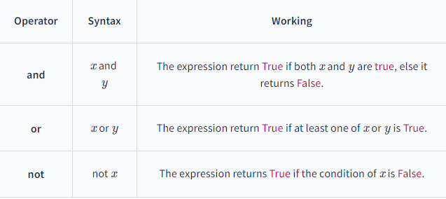
6. Logical Expressions
As the name suggests, a logical expression performs the logical computation, and the overall expression results in either True or False (boolean result)

Slide 11
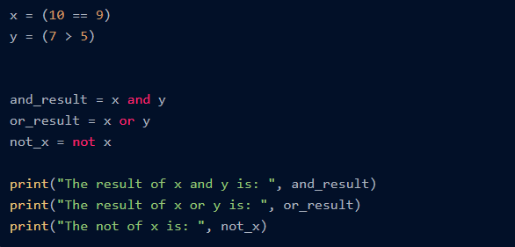
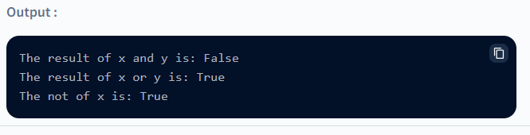

Slide 12
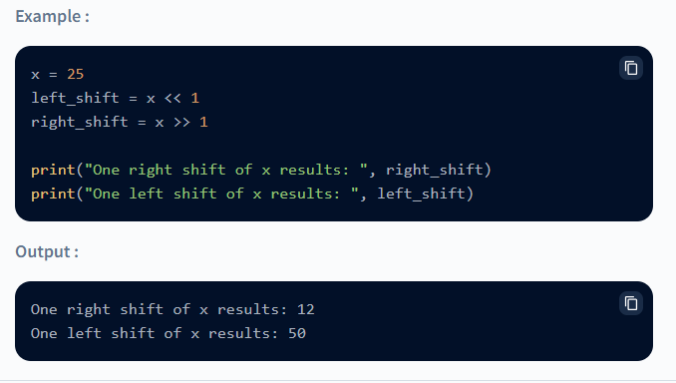
7. Bitwise Expressions
The expression in which the operation or computation is performed at the bit level is known as a bitwise expression in Python. The bitwise expression contains the bitwise operators

Slide 13
Python Bitwise Operators
In Python, bitwise operators are used to perform bitwise calculations on integers. The integers are first converted into binary and then operations are performed on each bit or corresponding pair of bits, hence the name bitwise operators. The result is then returned in decimal format.
Python bitwise operators work only on integers.

Slide 14
OPERATOR | NAME | DESCRIPTION | SYNTAX
& | Bitwise AND | Result bit 1,if both operand bits are 1;otherwise results bit 0. | x & y
| | Bitwise OR | Result bit 1,if any of the operand bit is 1; otherwise results bit 0. | x | y
~ | Bitwise NOT | inverts individual bits | ~x
^ | Bitwise XOR | Results bit 1,if any of the operand bit is 1 but not both, otherwise results bit 0. | x ^ y
>> | Bitwise right shift | The left operand’s value is moved toward right by the number of bits specified by the right operand. | x>>
<< | Bitwise left shift | The left operand’s value is moved toward left by the number of bits specified by the right operand. | x<<

Slide 15
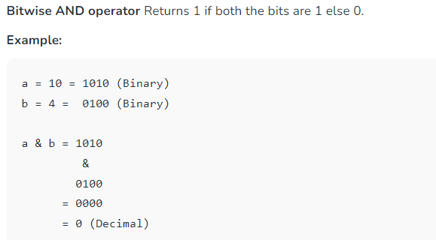

Slide 16
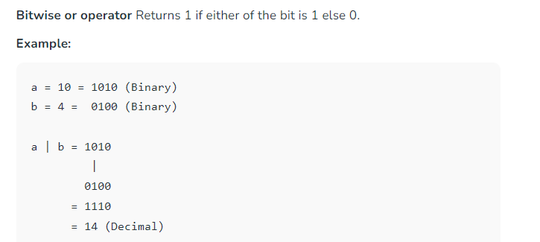

Slide 17
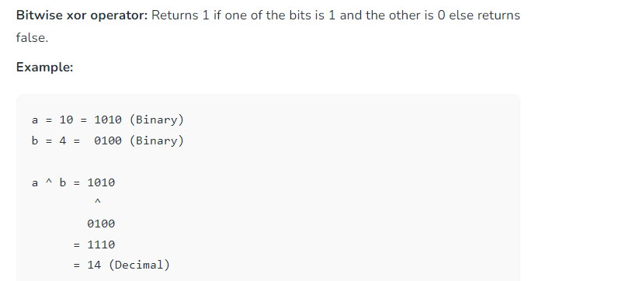

Slide 18
Shift Operators
These operators are used to shift the bits of a number left or right thereby multiplying or dividing the number by two respectively. They can be used when we have to multiply or divide a number by two.
Bitwise right shift: Shifts the bits of the number to the right and fills 0 on voids left( fills 1 in the case of a negative number) as a result. Similar effect as of dividing the number with some power of two.
Example:
Example 1:
a = 10 = 0000 1010 (Binary)
a >> 1 = 0000 0101 = 5

Slide 19
Bitwise left shift: Shifts the bits of the number to the left and fills 0 on voids right as a result. Similar effect as of multiplying the number with some power of two.
Example:
a = 5 = 0000 0101 (Binary)
a << 1 = 0000 1010 = 10
a << 2 = 0001 0100 = 20

Slide 20
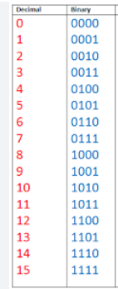

Slide 21
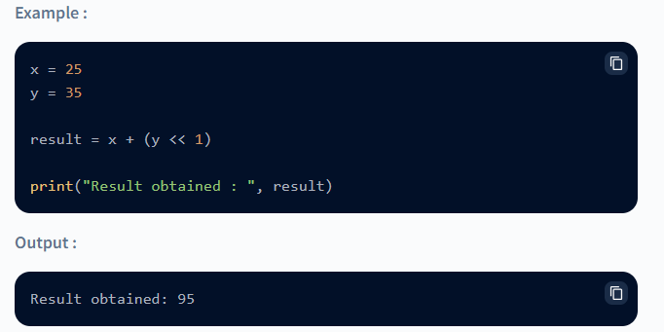
8. Combinational Expressions
As the name suggests, a combination expression can contain a single or multiple expressions which result in an integer or boolean value depending upon the expressions involved.

Slide 22
Multiple Operators in Expression (Operator Precedence)
Precedence Operator Name
1. ( ) [ ] { } Parenthesis
2. ** Exponentiation
3. -value , +value , ~value Unary plus or minus, complement
4. / * // % Multiply, Divide, Modulo
5. + – Addition & Subtraction
6. >> << Shift Operators
7. & Bitwise AND
8. ^ Bitwise XOR
9. pipe symbol Bitwise OR
10. >= <= > < Comparison Operators
11. == != Equality Operators
12. = += -= /= *= Assignment Operators
13. is, is not, in, not in Identity and membership operators
14. and, or, not Logical Operators

Slide 23
Print Statements in python
The print() function prints the specified message to the screen, or other standard output device.
The message can be a string, or any other object, the object will be converted into a string before written to the screen.
Syntax
print(object(s), sep=separator, end=end, file=file, flush=flush)

Slide 24
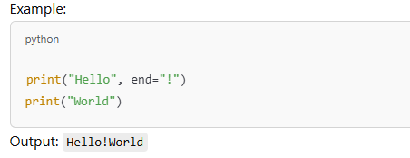
Parameter Values
Parameter | Description
object(s) | Any object, and as many as you like. Will be converted to string before printed
sep='separator' | Optional. Specify how to separate the objects, if there is more than one. Default is ' '
end='end' | Optional. Specify what to print at the end. Default is '\n' (line feed)
file | Optional. An object with a write method. Default is sys.stdout
flush | Optional. A Boolean, specifying if the output is flushed (True) or buffered (False). Default is False

Slide 25
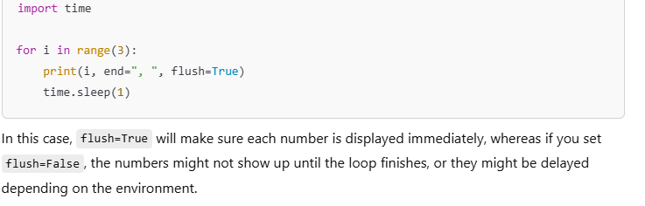

Slide 26
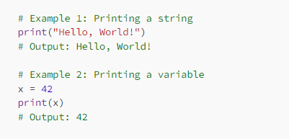
. Print with the ‘print’ function
The most basic way to print in Python is to use the ‘print’ function. This function takes one or more arguments, which can be variables, strings, or any other data type. The ‘print’ function automatically adds a new line character at the end of the output, so each subsequent print statement starts on a new line.

Slide 27
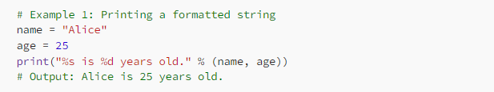
2. Print with string formatting
String formatting is a powerful technique that allows you to insert values into a string. In Python, you can use the ‘%’ operator to format a string. This operator takes a string on the left side and one or more values on the right side, separated by commas.

Slide 28
%s is a placeholder for a string, and %d is a placeholder for an integer.
The % operator is used to format the string by replacing each placeholder with the corresponding value.
The values to be substituted are provided in a tuple (name, age).

Slide 29
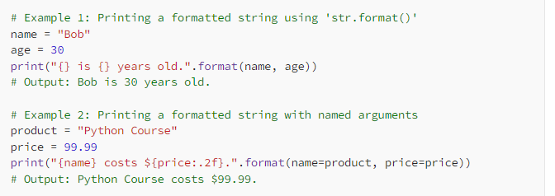
3. Print with the ‘str.format()’ method
The ‘str.format()’ method is a newer, more versatile way of formatting strings in Python. This method allows you to insert values into a string using curly braces ‘{}’, and then pass those values as arguments to the ‘format()’ method.

Slide 30
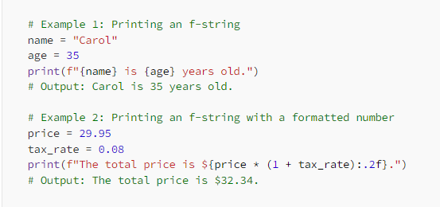
4. Print with the ‘f-string’ syntax
The ‘f-string’ syntax is a newer, even more, concise way of formatting strings in Python. This syntax allows you to embed expressions directly into string literals, by prefixing the string with the letter ‘f’.

Slide 31
Datatypes in Python
Every value has a datatype, and variables can hold values. Python is a powerfully composed language; consequently, we don't have to characterize the sort of variable while announcing it. The interpreter binds the value implicitly to its type
The storage method for each of the standard data types that Python provides is specified by Python. The following is a list of the Python-defined data types.
Numbers
Sequence Type
Boolean
Set
Dictionary
.

Slide 32
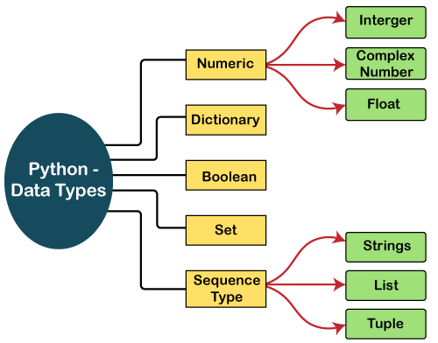

Slide 33
Integers
Integers are whole numbers. They have no fractional parts.
Integers can be positive or negative.
There are two types of integers in Python:
i) Integers(Signed) : It is the normal integer representation of whole numbers using the digits 0 to 9. Python provides single int data type to store any integer whether big or small. It is signed representation i.e. it can be positive or negative.

Slide 34
Demonstration of Integer-
Addition of two integer number
a=int(input("Enter the value of a:"))
b=int(input("Enter the value of b:"))
sum=a+b print("The sum of two integers=",sum)
Output:
Enter the value of a: 45
Enter the value of b: 67
The sum of two integers= 112

Slide 35
Floating Point Numbers
A number having fractional part is a floating point number. It has a decimal point. It is written in two forms :
i) Fractional Form : Normal decimal notation e.g. 675.456
ii) Exponent Notation: It has mantissa and exponent. e.g. 6.75456E2
Advantage of Floating point numbers:
They can represent values between the integers.
They can represent a much greater range of values.
Disadvantage of Floating point numbers:
Floating-point operations are usually slower than integer operations.

Slide 36
Demonstration of Floating Point Data Type
Demonstration of Float Number-
Calculate Simple Interest
princ=float(input("Enter the Principal Amount:"))
rate=float(input("Enter the Rate of interest:"))
time=float(input("Enter the Time period:"))
si=(princ*rate*time)/100
print("The Simple Interest=",si)
Output:
Enter the Principal Amount:5000
Enter the Rate of interest:8.5
Enter the Time period:5.5
Simple Interest= 2337.5

Slide 37
Complex Number
Python represents complex numbers in the form a+bj. #Demonstration of Complex Number-
Sum of two Complex Numbers
a=7+8j
b=3.1+6j
c=a+b
print("Sum of two Complex Numbers")
print(a,"+",b,"=",c)
Output: (7+8j) + (3.1+6j) = (10.1+14j)

Slide 38
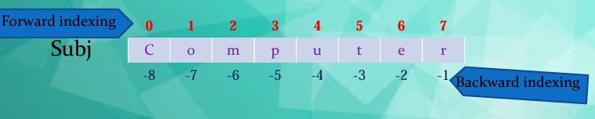
Strings
A String is a group of valid characters enclosed in Single or Double quotation marks.
A string can group any type of known characters i.e. letters ,numbers and special characters.
A Python string is a sequence of characters and each character can be accessed by its index either by forward indexing or by backward indexing. e.g. subj=“Computer”

Slide 39
An Python, Strings are arrays of bytes representing Unicode characters. A string is a collection of one or more characters put in a single quote, double-quote or triple quote. In python there is no character data type, a character is a string of length one. It is represented by str class.

Slide 40
Demonstration of String Data Type
To input string & print it
my_name=input("What is your Name? :")
print("Greetings!!!")
print("Hello!",my_name)
print("How do you do?")
Output : What is your Name? :Kshamta Mathur
Greetings!!!
Hello! Kshamta Mathur
How do you do?

Slide 41
List
Lists are just like dynamic sized arrays, declared in other languages (vector in C++ and ArrayList in Java).
Lists need not be homogeneous always which makes it a most powerful tool in Python.
A single list may contain DataTypes like Integers, Strings, as well as Objects.
Lists are mutable, and hence, they can be altered even after their creation.
List in Python are ordered and have a definite count.
The elements in a list are indexed according to a definite sequence and the indexing of a list is done with 0 being the first index.
Each element in the list has its definite place in the list, which allows duplicating of elements in the list, with each element having its own distinct place and credibility.

Slide 42
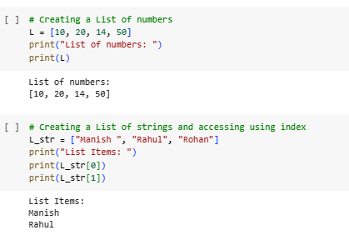

Slide 43
Tuple
Tuple is a collection of Python objects much like a list. The sequence of values stored in a tuple can be of any type, and they are indexed by integers.
Values of a tuple are syntactically separated by ‘commas’. Although it is not necessary, it is more common to define a tuple by closing the sequence of values in parentheses. This helps in understanding the Python tuples more easily.
In someways a tuple is similar to a list in terms of indexing, nested objects and repetition but a tuple is immutable unlike lists which are mutable.

Slide 44
Immutable: Once a tuple is created, you cannot add, remove, or modify elements. This makes tuples suitable for representing fixed collections of items.
Ordered: Tuples maintain the order of elements, meaning the order in which elements are inserted is preserved.
Heterogeneous: Tuples can contain elements of different data types, such as integers, strings, and floats.
Length: The length of a tuple is the number of elements it contains, which can be obtained using the len() function.

Slide 45

Features of tuple
Immutable: Once a tuple is created, you cannot add, remove, or modify elements. This makes tuples suitable for representing fixed collections of items.
Ordered: Tuples maintain the order of elements, meaning the order in which elements are inserted is preserved.
Heterogeneous: Tuples can contain elements of different data types, such as integers, strings, and floats.
Length: The length of a tuple is the number of elements it contains, which can be obtained using the len() function.
Tuples can contain other tuples, allowing for nested structures.

Slide 46
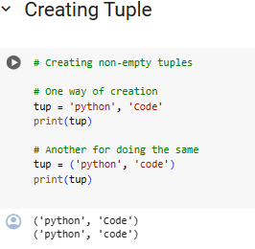

Slide 47
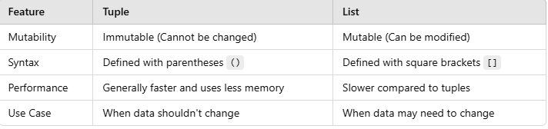
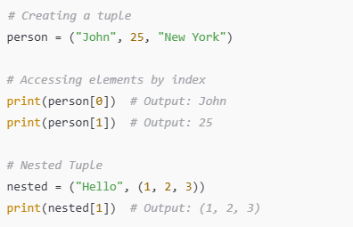
Difference Between Tuple and List:

Slide 48
Dictionary
Dictionaries are unordered collection of elements in curly braces in the form of a key:value pairs that associate keys to values.
Dictionaries are Mutable. As dictionary elements does not have index value ,the elements are accessed through the keys defined in key:valuepairs.
#Demonstration of Dictionary-
Program to save Phone nos. in dictionary & print it Phonedict={“Madhav”:9876567843,”Dilpreet”:7650983457,”Murugan”:90672 08769,”Abhinav”:9870987067}
print(Phonedict)
Output: {'Madhav': 9876567843, 'Dilpreet': 7650983457, 'Murugan': 9067208769, 'Abhinav': 9870987067}

Slide 49
List | Tuple | Set | Dictionary
A list is a non-homogeneous data structure that stores the elements in columns of a single row or multiple rows. | A Tuple is also a non-homogeneous data structure that stores elements in columns of a single row or multiple rows. | The set data structure is also a non-homogeneous data structure but stores the elements in a single row. | A dictionary is also a non-homogeneous data structure that stores key-value pairs.
The list can be represented by [ ] | Tuple can be represented by ( ) | The set can be represented by { } | The dictionary can be represented by { }
The list allows duplicate elements | Tuple allows duplicate elements | The Set will not allow duplicate elements | The dictionary doesn’t allow duplicate keys.
The list can use nested among all | Tuple can use nested among all | The set can use nested among all | The dictionary can use nested among all
Example: [1, 2, 3, 4, 5] | Example: (1, 2, 3, 4, 5) | Example: {1, 2, 3, 4, 5} | Example: {1: “a”, 2: “b”, 3: “c”, 4: “d”, 5: “e”}
A list can be created using the list() function | Tuple can be created using the tuple() function. | A setA dictionary can be created using the set() function | A dictionary can be created using the dict() function.
A list is mutable i.e we can make any changes in the list. | A tuple is immutable i.e we can not make any changes in the tuple. | A set is mutable i.e we can make any changes in the set, ut elements are not duplicated. | A dictionary is mutable, ut Keys are not duplicated.
List is ordered | Tuple is ordered | Set is unordered | Dictionary is ordered (Python 3.7 and above)
Creating an empty list l=[] | Creating an empty Tuple t=() | Creating a set a=set() b=set(a) | Creating an empty dictionary d={}

